Slide 1







Technologies Data Survey Report
By - Abhishek Singh Sengar
12thJune, 2021

Slide 2



Table of Contents
Executive Summary
Introduction
Methodology
Results
Visualization – Charts
Dashboard
Discussion
Findings & Implications
Conclusion
Appendix

Slide 3

EXECUTIVE SUMMARY
A modified subset of Stack Overflow data consisting of two data sets based on the demographics and data technologies were analyzed to identify the present and future data technologies trends among people of various different age groups all across the world.
Dashboard are created with three different tabs i.e. current data technologies ,future data technologies and demographics of respondent. IBM Cognos Dashboard Embedded (CDE) platform was used to analyze and visualize the results.
From the Current technologies dashboard it was clearly visible that Java Script and MySQL were most popular languages and Databased respectively.
Windows and jQuery were preferred platform and webFrame to worked with

Slide 4

From the future trend technologies dashboard it was clearly visible that HTML/CSS and Elasticsearch languages and Databased respectively were most popularly desired to be worked for the next upcoming year
Python and HTML were preferred platform and webFrame to be worked for the next upcoming year .
Lastly, Demographics analysis was done in the third tab and it showed that:93.7% respondent were male with majority of them being from USA and India in the age group of 21 to 43.
From last visualization on Demographics Dashboard it shows varied types of data technologies are preferred by students pursuing bachelors and master’s degree. Among young generations we may see most of the population gravitating towards languages easy to learn and help automation tasks ex:-Python, HTML
Most of the BIG Four/Five also affects the general behavior of majority of population

Slide 5

INTRODUCTION
To visualize the data ,dashboards were created to emphasis on the present and future trends of data technologies.
Here are some approaches
Problem: From such a clustered data ,we need to analyze the present data technologies and future data trends considering the various different demographics of the respondents
Through creating dashboards using IBM Cognos Dashboard, we would be able to visualize our data based on top 10 present and future data technology trends based on respondent gender ,formal education ,age and countries.

Slide 6

METHODOLOGY
A modified subset of Stack Overflow data consisting of two data sets based on the demographics and data technologies were used to visualize the present and future data trends based on their demographics
As these data sets were subsets of data sets and therefore they did not require a lot of cleaning . Hence no particular methodology was used to visualize the data. We only used filtering option to ignore the nulls values from data
IBM Cognos dashboard was used to create interactive Dashboards

Slide 7
RESULTS
The data was collected from stack overflow blog under ODBI: Open Database License .It was further modified and use for the analysis purpose.
It consisted of two data sets :Survey data technology normalized consisted of approximately 75K respondents querying them about the present and future data technologies interest . Then using visualization tools such as bar, columns graphs along with tree maps and hierarchy trees were used to analysis the top trending present and future technologies trends.
Survey data demographics was more clustered data set a which involved around 11K respondents answering about various demographics questions such as country , age , education level, ethnicity, gender etc. The results of these finding were visualized in form of bar ,line charts along with maps.
In next few slides we will be discussing the crucial findings from the data sets for present and future technologies trends

Slide 8
PROGRAMMING LANGUAGE TRENDS
Current Year
Next Year

Slide 9
PROGRAMMING LANGUAGE TRENDS - FINDINGS & IMPLICATIONS
Findings
Implications
JavaScript and HTML were the languages are most preferred due to growing internet and friendly syntax.
Followed by SQL, Bash/Shell and Python for current trends as these are mostly used in a backend process or data analysis
The job market would see a higher influx of JavaScript and HTML programmers along with Python for task automation using Django
In upcoming years there might be growth in Highlevel languages like R and Python and slump in C and C++

Slide 10
DATABASE TRENDS
Current Year
Next Year
< Bar chart of top 5 databases for the current year goes here >
< Bar chart of top 5 databases for the next year goes here.>

Slide 11
DATABASE TRENDS - FINDINGS & IMPLICATIONS
Findings
My SQL dominates the Database platform preferred by developers as used officially by MNC’s
PostgreSQL is the next most preferred database platform due to it increase functionality and open license
MongoDB as a database platform is expected to show more growth in future.
Implications
We may see more organization preferring towards MongoDB and PostgreSQL, as there popularity among users
MongoDB and PostgreSQL as the next essential databases skills to have in resume
MySQL in upcoming years seems to be falling behind principally due to its cost factor.

Slide 12

DASHBOARD
IBM PROJECT DASHBOARD
The above dashboard link will redirect to the sources of the visualizations shown in upcoming DECKS :
https://dataplatform.cloud.ibm.com/dashboards/2d196a25-b1cc-454b-b56d-620ac20c8898?project_id=33438cd3-ec97-417d-9665-12daac6e8cd7

Slide 13
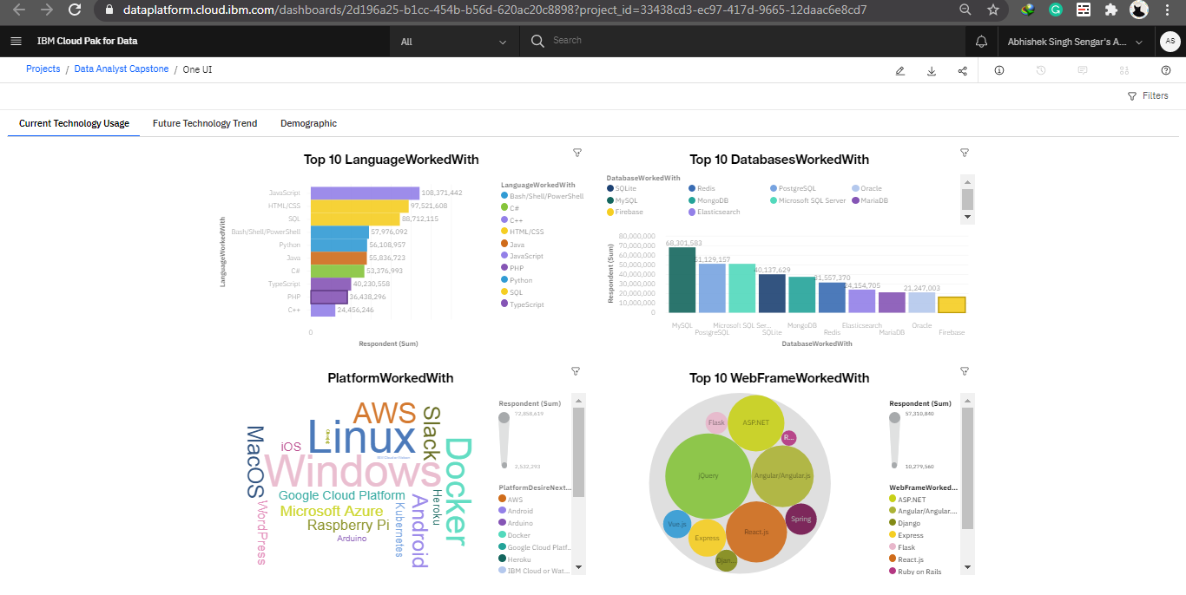
Current Technology Usage

Slide 14
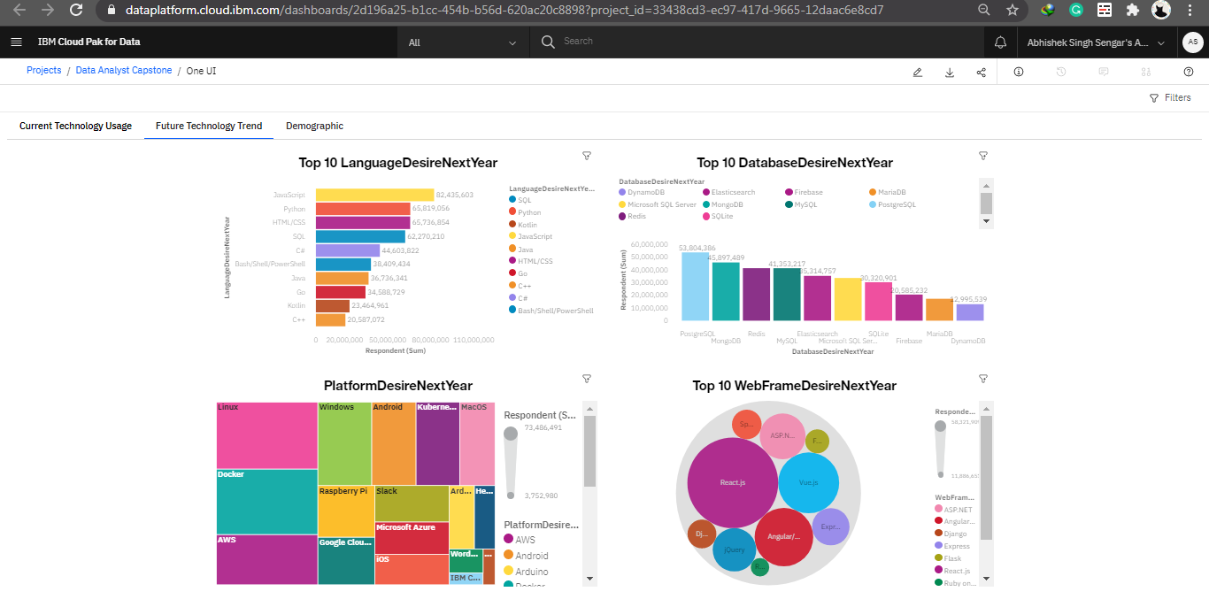
Future Technology Trend

Slide 15
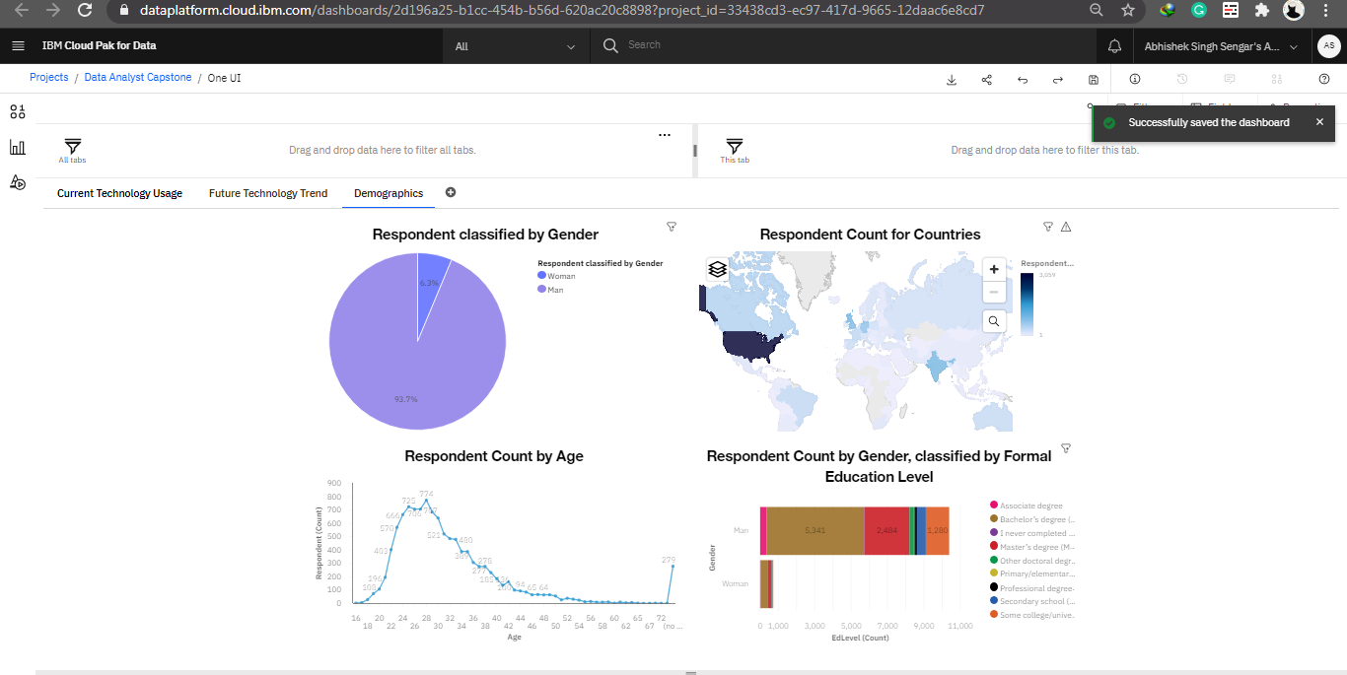
Demographics

Slide 16
DISCUSSION
Languages: Will SQL exist and if so who will be the major market player?
Will Python would continue to grow or be replaced with languages like Julia or some other new language in the new future emerging languages?
MongoDB and PostgreSQL might be able to replace MySQL in emerging times can Oracle help to improve and hold its position
MySQL declining is so drastically can it be due to external factors?
How MNC’s will play major role in replacing future languages like GO,PHP,C++ and other current major languages?

Slide 17
OVERALL FINDINGS & IMPLICATIONS
Findings
The database technologies surveys results shows a domination by male population, majority of them between age group 21 to 45.
Bachelor's and Master’s students highly prefer doing a specialization in data technology.
Implications
Seeing the popularity among youth, we can see more bootstrap camps than ever in past due to increased demand.
The popularity trends may be similar in other countries too and we may see various MNC’s diversifying into this sector.

Slide 18

CONCLUSION
Analyzing dataset we are able to understand current and future trends in technologies application and usage
From the data visualization in demographics it is clear that the data technologies trends are majorly affected by young age groups
Popular languages like HTML and JavaScript will remain the most preferred languages to be worked with. Even in the future due to its multipurpose use on the internet and applications.
Among Databases, the popularity of MySQL decreasing and which may be replaced by MongoDB and PostgreSQL which are easy to use and cost effective.
Enhancing skills and Upskilling may come across in many MNC’s diversifying into data technology to be competitive.
Though there is a major contribution of male but in upcoming trends, women are showing steep growth.

Slide 19

APPENDIX
Resources used : Database taken from :
Stack Overflow for hosting dataset as ODBL: Open Database License
IBM Cognos dashboard were used for creating Dashboards
Acknowledgement:
Coursera and IBM Skill Network for making these specialization possible
Also would like to thank platform like cognitive.ai for making these hands in labs exercise and there support to all learners

Slide 20
GITHUB JOB POSTINGS

Slide 21
POPULAR LANGUAGES

Slide 22
Additional Notes
APPENDIX
Data will null or no value has been dropped to make standardized and appealing visual
At least 5 languages are a must for a developer or programmer to work in challenging environments with ease, flexibility
Using contrast colors, a similar color schema presentation is made homogeneous and easy to read
Varied Visualizations has been used to capture the crux of the survey and key insights

